Slide 1
DeckTechCentral
Christian Messmer, Paul Shriner, Adir Turgeman, Luke Vukovich

Slide 2

Project Overview
DeckTechCentral (DTC) is a Magic: The Gathering deck list management system.
Magic: The Gathering (Magic or MTG) is a strategic card game where players cast spells, summon creatures, and use artifacts to defeat their opponents.
DTC aims to help players with an aspect of the game, that being deck building.
While newcomers can benefit from using DTC, it is not intended to teach someone how to play the game.

Slide 3

Project Features
DTC allows searching and viewing MTG cards.
This includes its information, rules, mana cost, power, and more.
DTC allows for searching, viewing, and creating user made decks.
DTC allows reviewing a deck by “liking” it.
A popular deck may get many likes, while an unpopular deck may get few likes.

Slide 4

Motivation
Players normally build their decks by hand.
While fun, it can be error-prone and is difficult if the player does not have the physical cards.
There have been deck-building services prior to DTC.
Examples: Moxfield, Archidekt, TappedOut, Frogtown.
We wanted to create our own take on an MTG deck list building service as a learning experience.

Slide 5
Technologies
React
Library for JavaScript, allows building user interfaces using components.
Vite
Used for building the page during development.
Scryfall API
API for retrieving information on Magic cards.
MongoDB
Document database system for storing data on the application.
Git/GitHub
Used for version control to keep track of all changes.

Slide 6

Open Api Spec
A document meant to help coordinate communication between the front-end and back-end.
Defines the paths and requirements of each path.
Helps integration efforts to minimize problems and confusion.

Slide 7
API Design Details
Uses .NET 8.0 due to its extensive implementations and libraries that helps create back-end APIs
Connects and writes to a MongoDB database
Uses JWT to help us Authenticate and Authorize user access

Slide 8

Front-End Details
RouterProvider allowed for easy page setup and scalability.
Designed with responsiveness in mind – usable on all devices.
React was useful for managing states and dynamic page loading.
Uses secure and cleansed cookies for storing login states.

Slide 9
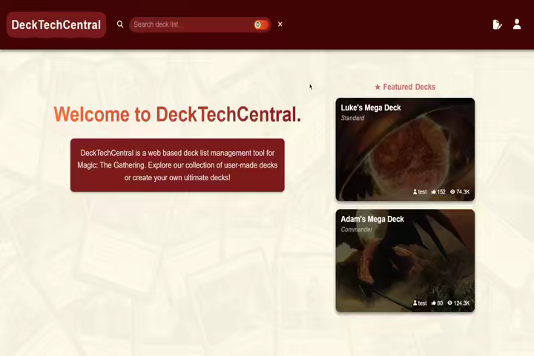
Next Slide

Slide 10

Challenges
Responsive Web Design
OAuth
API Specifications
General Group Work Complications

Slide 11

Questions
All questions are welcome!

